Slide 1
Linear Models
Simple Linear Regression
Multiple Regression
Logistic Regression
Poisson Regression
2. Nonlinear Models
Nonlinear least squares
Generalized additive models
Decision trees
Random forests
3. Time Series:
Autoregressive Moving Average
VAR
GARCH
4. Clustering
K –Means
PAM
Hierarchical Clustering

Slide 2
Regression Analysis
Regression analysis is very widely used statistical tool to establish a relationship model between two variables.
One of these variable is called predictor variable whose value is gathered through experiments.
The other variable is called response variable whose value is derived from the predictor variable.
1. Linear Regression
In linear regression these two variables are related through an equation, where exponent (power) of both these variables is 1.
Mathematically a linear relationship represents a straight line when plotted as a graph.
A non-linear relationship where the exponent of any variable is not equal to 1 creates a curve.
The general mathematical equation for a linear regression is −
y = ax + b

Slide 3
Following is the description of the parameters used :
y is the response variable.
x is the predictor variable.
a and b are constants which are called the coefficients.
Steps to Establish a Regression
A simple example of regression is predicting weight of a person when his height is known. To do this we need to have the relationship between height and weight of a person.
The steps to create the relationship is −
Carry out the experiment of gathering a sample of observed values of height and corresponding weight.
Create a relationship model using the lm() functions in R.
Find the coefficients from the model created and create the mathematical equation using these
Get a summary of the relationship model to know the average error in prediction. Also called residuals.
To predict the weight of new persons, use the predict()function in R.

Slide 4
Input Data
Below is the sample data representing the observations −
# Values of height 151, 174, 138, 186, 128, 136, 179, 163, 152, 131
# Values of weight. 63, 81, 56, 91, 47, 57, 76, 72, 62, 48
lm() Function
This function creates the relationship model between the predictor and the response variable.
Syntax
The basic syntax for lm() function in linear regression is −
lm(formula,data) Following is the description of the parameters used −
formula is a symbol presenting the relation between x and y.
data is the vector on which the formula will be applied.
Create relationship model and get the coefficients
>x <- c(151, 174, 138, 186, 128, 136, 179, 163, 152, 131)
>y <- c(63, 81, 56, 91, 47, 57, 76, 72, 62, 48)
>relation <- lm(y~x)
>print(relation)

Slide 5
Call:
lm(formula = y ~ x)
Coefficients:
(Intercept) x
-38.4551 0.6746
Get the summary of the relationship
>print(summary(relation))
Call:
lm(formula = y ~ x)
Residuals:
Min 1Q Median 3Q
-6.3002 -1.6629 0.0412 1.8944
Max
3.9775
Coefficients:
Estimate Std. Error
(Intercept) -38.45509 8.04901
x 0.67461 0.05191
t value Pr(>|t|)
(Intercept) -4.778 0.00139 **
x 12.997 1.16e-06 ***
---
Signif. codes:
0 ‘***’ 0.001 ‘**’ 0.01 ‘*’ 0.05
‘.’ 0.1 ‘ ’ 1
Residual standard error: 3.253 on 8 degrees of freedom
Multiple R-squared: 0.9548, Adjusted R-squared: 0.9491
F-statistic: 168.9 on 1 and 8 DF, p-value: 1.164e-06

Slide 6
predict()
Syntax
predict(object, newdata)
Following is the description of the parameters used:
object is the formula which is already created using the lm() function.
newdata is the vector containing the new value for predictor variable.
Predict the weight of new persons
# The predictor vector.
>x <- c(151, 174, 138, 186, 128, 136, 179, 163, 152, 131)
# The resposne vector.
>y <- c(63, 81, 56, 91, 47, 57, 76, 72, 62, 48)
# Apply the lm() function.
>relation <- lm(y~x)
# Find weight of a person with height 170.
>a <- data.frame(x = 170)
>result <- predict(relation,a)
>print(result)
1
76.22869

Slide 7
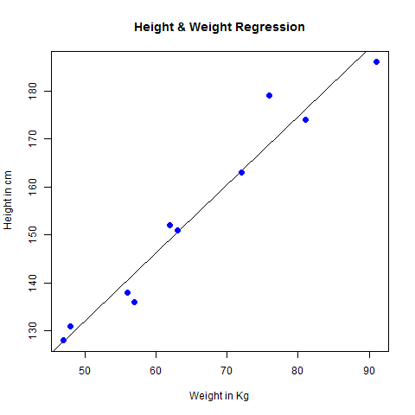
Visualize the Regression Graphically
# Create the predictor and response variable.
>x<- c(151, 174, 138, 186, 128, 136, 179, 163, 152, 131)
>y <- c(63, 81, 56, 91, 47, 57, 76, 72, 62, 48)
>relation <- lm(y~x)
# Give the chart file a name.
>png(file = "linearregression.png")
# Plot the chart.
>plot(y,x,col = "blue",main = "Height & Weight Regression",
abline(lm(x~y)),cex = 1.3,pch = 16,xlab = "Weight in Kg",ylab = "Height in cm")
# Save the file.
>dev.off()

Slide 8
2. Multiple Regression
Multiple regression is an extension of linear regression into relationship between more than two variables. In simple linear relation we have one predictor and one response variable, but in multiple regression we have more than one predictor variable and one response variable.
The general mathematical equation for multiple regression is
y = a + b1x1 + b2x2 +...bnxn
Following is the description of the parameters used
y is the response variable.
a, b1, b2...bn are the coefficients.
x1, x2, ...xn are the predictor variables.
We create the regression model using the lm() function in R. The model determines the value of the coefficients using the input data. Next we can predict the value of the response variable for a given set of predictor variables using these coefficients.

Slide 9
lm()
This function creates the relationship model between the predictor and the response variable.
Syntax
lm(y ~ x1+x2+x3...,data)
Following is the description of the parameters used
formula is a symbol presenting the relation between the response variable and predictor variables.
data is the vector on which the formula will be applied.
Example
Input Data
Consider the data set "mtcars" available in the R environment. It gives a comparison between different car models in terms of mileage per gallon (mpg), cylinder displacement("disp"), horse power("hp"), weight of the car("wt") and some more parameters.
The goal of the model is to establish the relationship between "mpg" as a response variable with "disp","hp" and "wt" as predictor variables. We create a subset of these variables from the mtcars data set for this purpose.

Slide 10
>input <- mtcars[,c("mpg","disp","hp","wt")]
>print(head(input))
mpg disp hp wt
Mazda RX4 21.0 160 110 2.620
Mazda RX4 Wag 21.0 160 110 2.875
Datsun 710 22.8 108 93 2.320
Hornet 4 Drive 21.4 258 110 3.215
Hornet Sportabout 18.7 360 175 3.440
Valiant 18.1 225 105 3.460
Create Relationship Model & get the Coeffients
input <- mtcars[,c("mpg","disp","hp","wt")]
# Create the relationship model.
model <- lm(mpg~disp+hp+wt, data = input)
# Show the model.
print(model)

Slide 11
# Get the Intercept and coefficients as vector elements.
cat("# # # # The Coefficient Values # # # ","\n")
a <- coef(model)[1]
print(a)
Xdisp <- coef(model)[2]
Xhp <- coef(model)[3]
Xwt <- coef(model)[4]
print(Xdisp)
print(Xhp)
print(Xwt)
Result
Call:
lm(formula = mpg ~ disp + hp + wt, data = input)
Coefficients:
(Intercept) disp hp wt
37.105505 -0.000937 -0.031157 -3.800891

Slide 12
# # # # The Coefficient Values # # #
(Intercept)
37.10551
disp
-0.0009370091
hp
-0.03115655
wt
-3.800891

Slide 13
3. Logistic Regressions
The Logistic Regression is a regression model in which the response variable (dependent variable) has categorical values such as True/False or 0/1. It actually measures the probability of a binary response as the value of response variable based on the mathematical equation relating it with the predictor variables.
The general mathematical equation for logistic regression is
y = 1/(1+e^-(a+b1x1+b2x2+b3x3+...))
Following is the description of the parameters used
y is the response variable.
x is the predictor variable.
a and b are the coefficients which are numeric constants.
The function used to create the regression model is the glm() function.
Syntax
glm(formula,data,family)
Following is the description of the parameters used
formula is the symbol presenting the relationship between the variables.
data is the data set giving the values of these variables.
family is R object to specify the details of the model. It's value is binomial for logistic regression.

Slide 14
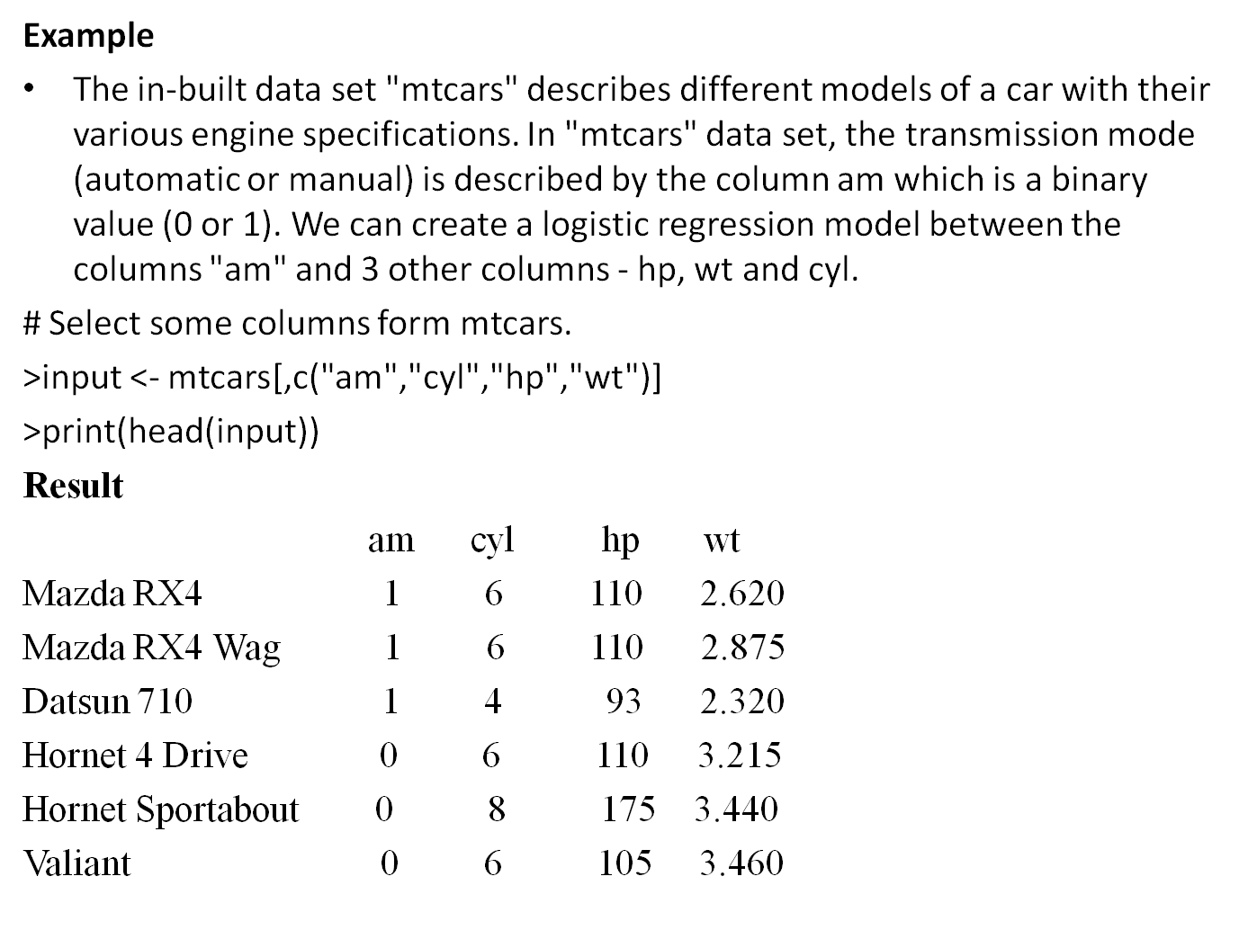

Slide 15
Create Regression Model
We use the glm() function to create the regression model and get its summary for analysis.
>input <- mtcars[,c("am","cyl","hp","wt")]
>am.data = glm(formula = am ~ cyl + hp + wt, data = input, family = binomial)
>print(summary(am.data))
Result
Call:
glm(formula = am ~ cyl + hp + wt, family = binomial, data = input)
Deviance Residuals:
Min 1Q Median 3Q Max
-2.17272 -0.14907 -0.01464 0.14116 1.27641
Coefficients:
Estimate Std. Error z value Pr(>|z|)
(Intercept) 19.70288 8.11637 2.428 0.0152 *
cyl 0.48760 1.07162 0.455 0.6491
hp 0.03259 0.01886 1.728 0.0840 .
wt -9.14947 4.15332 -2.203 0.0276 *
---

Slide 16
Signif. codes: 0 ‘***’ 0.001 ‘**’ 0.01 ‘*’ 0.05 ‘.’ 0.1 ‘ ’ 1
(Dispersion parameter for binomial family taken to be 1)
Null deviance: 43.2297 on 31 degrees of freedom
Residual deviance: 9.8415 on 28 degrees of freedom
AIC: 17.841
Number of Fisher Scoring iterations: 8
Conclusion
In the summary as the p-value in the last column is more than 0.05 for the variables "cyl" and "hp", we consider them to be insignificant in contributing to the value of the variable "am". Only weight (wt) impacts the "am" value in this regression model.

Slide 17
4. Poisson Regression
Poisson Regression involves regression models in which the response variable is in the form of counts and not fractional numbers. For example, the count of number of births or number of wins in a football match series. Also the values of the response variables follow a Poisson distribution.
The general mathematical equation for Poisson regression is −
log(y) = a + b1x1 + b2x2 + bnxn.....
Following is the description of the parameters used −
y is the response variable.
a and b are the numeric coefficients.
x is the predictor variable.
The function used to create the Poisson regression model is the glm() function.
Syntax:
glm(formula,data,family)
formula is the symbol presenting the relationship between the variables.
data is the data set giving the values of these variables.
family is R object to specify the details of the model. It's value is 'Poisson' for Logistic Regression.

Slide 18
Example
We have the in-built data set "warpbreaks" which describes the effect of wool type (A or B) and tension (low, medium or high) on the number of warp breaks per loom. Let's consider "breaks" as the response variable which is a count of number of breaks. The wool "type" and "tension" are taken as predictor variables.
Input Data
>input<-warpbreaks
>print(head(input))
Result:
breaks wool tension
1 26 A L
2 30 A L
3 54 A L
4 25 A L
5 70 A L
6 52 A L

Slide 19
Create Regression Model
>output <-glm(formula = breaks ~ wool+tension, data = warpbreaks, family = poisson)
>print(summary(output))
Result:
Call:
glm(formula = breaks ~ wool + tension, family = poisson, data = warpbreaks)
Deviance Residuals:
Min 1Q Median 3Q Max
-3.6871 -1.6503 -0.4269 1.1902 4.2616
Coefficients:
Estimate Std. Error z value Pr(>|z|)
(Intercept) 3.69196 0.04541 81.302 < 2e-16 ***
woolB -0.20599 0.05157 -3.994 6.49e-05 ***
tensionM -0.32132 0.06027 -5.332 9.73e-08 ***
tensionH -0.51849 0.06396 -8.107 5.21e-16 ***
---

Slide 20
Signif. codes: 0 ‘***’ 0.001 ‘**’ 0.01 ‘*’ 0.05 ‘.’ 0.1 ‘ ’ 1
(Dispersion parameter for poisson family taken to be 1)
Null deviance: 297.37 on 53 degrees of freedom
Residual deviance: 210.39 on 50 degrees of freedom
AIC: 493.06
Number of Fisher Scoring iterations: 4

Slide 21
Non-linear Models
When modeling real world data for regression analysis, we observe that it is rarely the case that the equation of the model is a linear equation giving a linear graph.
Most of the time, the equation of the model of real world data involves mathematical functions of higher degree like an exponent of 3 or a sin function.
In such a scenario, the plot of the model gives a curve rather than a line. The goal of both linear and non-linear regression is to adjust the values of the model's parameters to find the line or curve that comes closest to your data.
On finding these values we will be able to estimate the response variable with good accuracy.
Non- Linear Least Squares
In Least Square regression, we establish a regression model in which the sum of the squares of the vertical distances of different points from the regression curve is minimized.
We generally start with a defined model and assume some values for the coefficients. We then apply the nls() function of R to get the more accurate values along with the confidence intervals.

Slide 22
Syntax
nls(formula, data, start)
Where
formula is a nonlinear model formula including variables and parameters.
data is a data frame used to evaluate the variables in the formula.
start is a named list or named numeric vector of starting estimates.
Example
We will consider a nonlinear model with assumption of initial values of its coefficients. Next we will see what is the confidence intervals of these assumed values so that we can judge how well these values fit into the model.
Equation is a = b1*x^2+b2
Lets assume the initial coefficients to be 1 and 3 and fit these values into nls().
Code:
>xvalues <- c(1.6,2.1,2,2.23,3.71,3.25,3.4,3.86,1.19,2.21)
>xvalues
[1] 1.60 2.10 2.00 2.23 3.71 3.25 3.40 3.86 1.19 2.21

Slide 23
>yvalues <- c(5.19,7.43,6.94,8.11,18.75,14.88,16.06,19.12,3.21,7.58)
>yvalues
[1] 5.19 7.43 6.94 8.11 18.75 14.88 16.06 19.12
[9] 3.21 7.58
>png(file = "nls.png")
>plot(xvalues,yvalues)
# Take the assumed values and fit into the model.
>model <- nls(yvalues ~ b1*xvalues^2+b2,start = list(b1 = 1,b2 = 3))
>model
Nonlinear regression model
model: yvalues ~ b1 * xvalues^2 + b2
data: parent.frame()
b1 b2
1.195 1.997
residual sum-of-squares: 1.082
Number of iterations to convergence: 1
Achieved convergence tolerance: 1.082e-08

Slide 24
# Plot the chart with new data by fitting it to a prediction from 100 data points.
>new.data <- data.frame(xvalues = seq(min(xvalues),max(xvalues),len = 100))
lines(new.data$xvalues,predict(model,newdata = new.data))
>new.data
xvalues
1 1.190000
2 1.216970
3 1.243939
4 1.270909
5 1.297879
6 1.324848
7 1.351818
8 1.378788
9 1.405758
1.432727
And so on 100

Slide 25
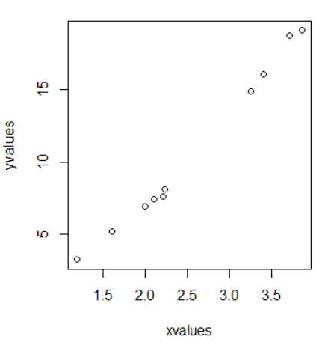
# Save the file.
>dev.off()
null device
1
# Get the sum of the squared residuals.
>print(sum(resid(model)^2))
[1] 1.081935
# Get the confidence intervals on the chosen values of the coefficients.
>print(confint(model))
Waiting for profiling to be done...
2.5% 97.5%
b1 1.137708 1.253135
b2 1.497364 2.496484
We can conclude that the value of b1 is more close to 1 while the value of b2 is more close to 2 and not 3.

Slide 26
Spline regression
Polynomial regression only captures a certain amount of curvature in a nonlinear relationship. An alternative, and often superior, approach to modeling nonlinear relationships is to use splines (P. Bruce and Bruce 2017).
Splines provide a way to smoothly interpolate between fixed points, called knots. Polynomial regression is computed between knots. In other words, splines are series of polynomial segments strung together, joining at knots (P. Bruce and Bruce 2017).
The R package splines includes the function bs for creating a b-spline term in a regression model.
You need to specify two parameters: the degree of the polynomial and the location of the knots. In our example, we’ll place the knots at the lower quartile, the median quartile, and the upper quartile:
We’ll create a model using a cubic spline (degree = 3):
Code:
>spline(x=c(1,2,3),y=c(3,16,6),n=9)
$x
[1] 1.00 1.25 1.50 1.75 2.00 2.25 2.50 2.75 3.00

Slide 27
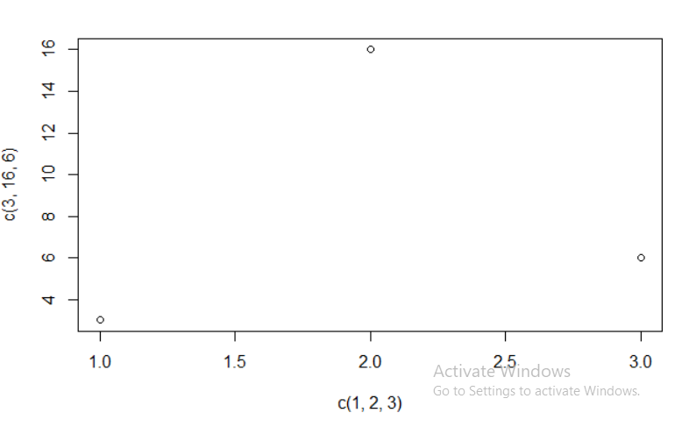
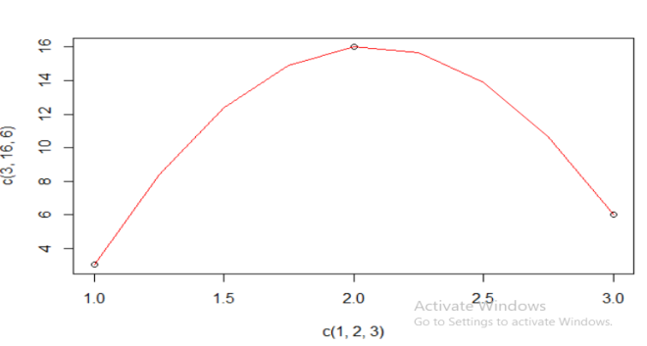
$y
[1] 3.00000 8.40625 12.37500 14.90625 16.00000
[6] 15.65625 13.87500 10.65625 6.00000
>splineout<-spline(x=c(1,2,3),y=c(3,16,6),n=9)
>splineout$x
[1] 1.00 1.25 1.50 1.75 2.00 2.25 2.50 2.75 3.00
>splineout$y
[1] 3.00000 8.40625 12.37500 14.90625 16.00000
[6] 15.65625 13.87500 10.65625 6.00000
>plot(c(1,2,3),c(3,16,6))
>points(splineout$x,splineout$y,type='l',col="red")

Slide 28
2. Generalized additive models
Once you have detected a non-linear relationship in your data, the polynomial terms may not be flexible enough to capture the relationship, and spline terms require specifying the knots.
Generalized additive models, or GAM, are a technique to automatically fit a spline regression. This can be done using the mgcv R package:
Code:
install.packages("faraway")
library(faraway)
data("ozone")
install.packages("mgcv")
library(mgcv)
gamobj<-gam(log(O3)~s(vh)+s(wind)+s(humidity)+s(temp)+s(ibh)+
s(dpg)+s(ibt)+s(vis)+s(doy),
family=gaussian(link=identity),data=ozone)
summary(gamobj)
pdf("GAMozone.pdf")
par(mfrow=c(3,3))
plot(gamobj)
dev.off()
plot(gamobj)

Slide 29
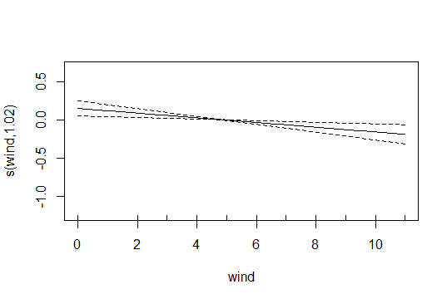
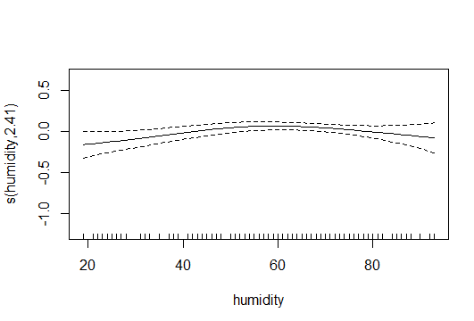
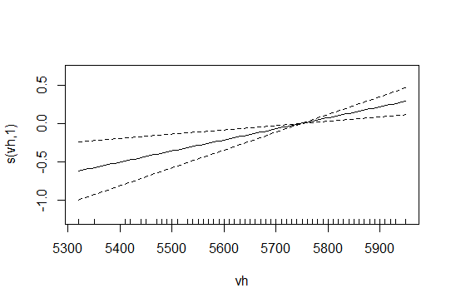
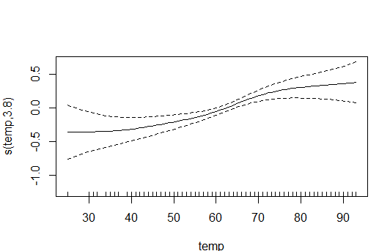
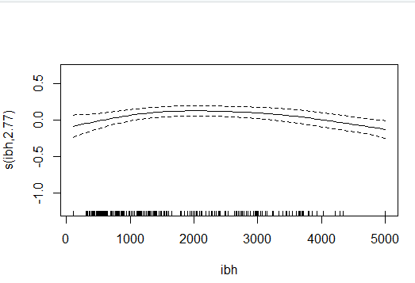
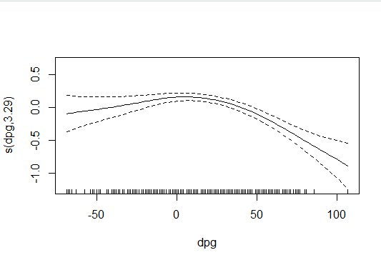
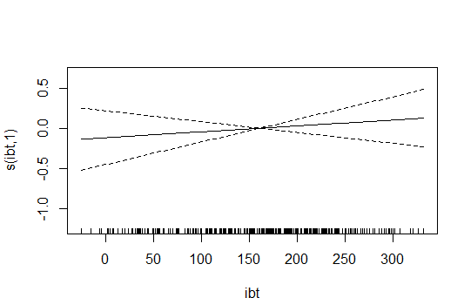
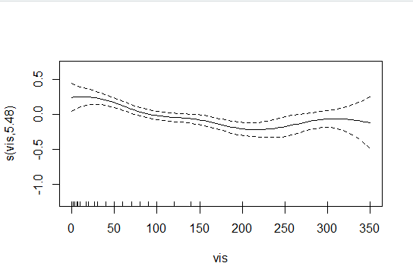

Slide 30
3. Décision Tree
Decision tree is a graph to represent choices and their results in form of a tree. The nodes in the graph represent an event or choice and the edges of the graph represent the decision rules or conditions.
It is mostly used in Machine Learning and Data Mining applications using R.
Examples of use of decision tress is − predicting an email as spam or not spam, predicting of a tumor is cancerous or predicting a loan as a good or bad credit risk based on the factors in each of these.
Generally, a model is created with observed data also called training data. Then a set of validation data is used to verify and improve the model. R has packages which are used to create and visualize decision trees.
For new set of predictor variable, we use this model to arrive at a decision on the category (yes/No, spam/not spam) of the data.
The R package "party" is used to create decision trees.
Code:
>install.packages("party")
>library(party)
The package "party" has the function ctree() which is used to create and analyze decision tree.

Slide 31
Syntax:
ctree(formula, data)
Where
formula is a formula describing the predictor and response variables.
data is the name of the data set used.
Input Data
We will use the R in-built data set named readingSkills to create a decision tree. It describes the score of someone's readingSkills if we know the variables "age","shoesize","score" and whether the person is a native speaker or not.
>print(head(readingSkills))
nativeSpeaker age shoeSize score
1 yes 5 24.83189 32.29385
2 yes 6 25.95238 36.63105
3 no 11 30.42170 49.60593
4 yes 7 28.66450 40.28456
5 yes 11 31.88207 55.46085
6 yes 10 30.07843 52.83124

Slide 32
# Create the input data frame.
>input.dat <- readingSkills[c(1:105),]
>input.dat
nativeSpeaker age shoeSize score
1 yes 5 24.83189 32.29385
2 yes 6 25.95238 36.63105
3 no 11 30.42170 49.60593
4 yes 7 28.66450 40.28456
5 yes 11 31.88207 55.46085
6 yes 10 30.07843 52.83124
7 no 7 27.25963 34.40229
8 yes 11 30.72398 55.52747
9 yes 5 25.64411 32.49935
no 7 26.69835 33.93269
And so on till 105
# Give the chart file a name.
>png(file = "decision_tree.png")

Slide 33
# Create the tree.
>output.tree <- ctree(nativeSpeaker ~ age + shoeSize + score, data = input.dat)
>output.tree
Conditional inference tree with 4 terminal nodes
Response: nativeSpeaker
Inputs: age, shoeSize, score
Number of observations: 105
1) score <= 38.30587; criterion = 1, statistic = 24.932
2) age <= 6; criterion = 0.993, statistic = 9.361
3) score <= 30.76591; criterion = 0.999, statistic = 14.093
4)* weights = 13
3) score > 30.76591
5)* weights = 9
2) age > 6
6)* weights = 21
1) score > 38.30587
7)* weights = 62

Slide 34
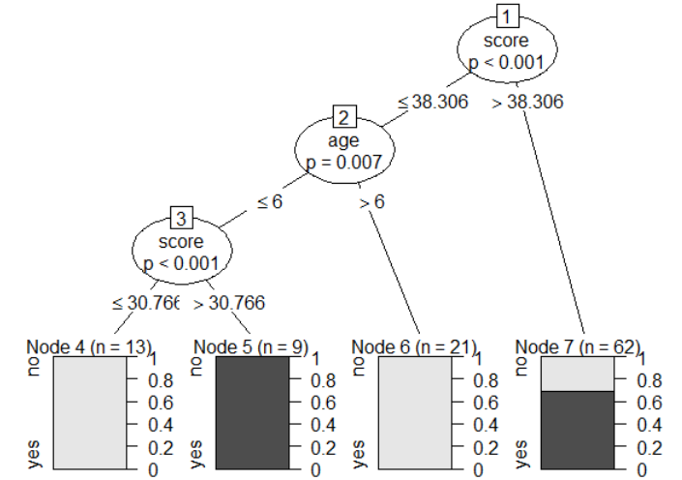
# Plot the tree.
>plot(output.tree)
# Save the file.
>dev.off()
RStudioGD
2
Conclusion
From the decision tree shown above we can conclude that anyone whose readingSkills score is less than 38.3 and age is more than 6 is not a native Speaker.

Slide 35
4. Random Forest
In the random forest approach, a large number of decision trees are created. Every observation is fed into every decision tree. The most common outcome for each observation is used as the final output. A new observation is fed into all the trees and taking a majority vote for each classification model.
An error estimate is made for the cases which were not used while building the tree. That is called an OOB (Out-of-bag) error estimate which is mentioned as a percentage.
The R package "randomForest" is used to create random forests.
Syntax:
randomForest(formula,data)
Formula : describing the predictor and response variables.
Data is the name of the data set used.
Install R Package
>install.packages(« randomForest)
>library(randomForest)
>print(head(readingSkills))

Slide 36
>head(readingSkills)
nativeSpeaker age shoeSize score
1 yes 5 24.83189 32.29385
2 yes 6 25.95238 36.63105
3 no 11 30.42170 49.60593
4 yes 7 28.66450 40.28456
5 yes 11 31.88207 55.46085
yes 10 30.07843 52.83124
# Create the forest.
>output.forest <- randomForest(nativeSpeaker ~ age + shoeSize + score,
data = readingSkills)
>output.forest
Call:
randomForest(formula = nativeSpeaker ~ age + shoeSize + score, data = readingSkills)
Type of random forest: classification
Number of trees: 500

Slide 37
No. of variables tried at each split: 1
OOB estimate of error rate: 1%
Confusion matrix:
no yes class.error
no 99 1 0.01
yes 1 99 0.01
Conclusion
From the random forest shown above we can conclude that the shoesize and score are the important factors deciding if someone is a native speaker or not. Also the model has only 1% error which means we can predict with 99% accuracy.

Slide 38
3. Time Series and Autocorrelation
A big part of statistics, particularly for financial and econometric data, is analyzing time series, data that are autocorrelated over time.
That is, one observation depends on previous observations and the order matters.
Autoregressive Moving Average
One of the most common ways of fitting time series models is to use autoregressive (AR), moving average(MA) or both (ARMA).
AR model can be thought of as linear regressions of the current value of the time series against previous values.
MA models are, similarly, linear regressions of the current value of the time series against current and previous residuals.
EG: We will make use of the world bank API to download gross domestic product (GDP) for a number of countries from 1960 through 2011.
>#load the World Bank API Package
>install.packages("WDI")
>require(WDI)
>gdp<-WDI(country=c("US","CA","GB","DE","CN","JP","SG","IL"),indicator = c("NY.GDP.PCAP.CD","NY.GDP.MKTP.CD"),start=1960,end=2011)

Slide 39
>names(gdp)<-c("iso2c","Country","Year","PerCapGDP","GDP")
>head(gdp)
iso2c Country Year PerCapGDP GDP
1 CA Canada 1960 2294.569 41093453545
2 CA Canada 1961 2231.294 40767969454
3 CA Canada 1962 2255.230 41978852041
4 CA Canada 1963 2354.839 44657169109
5 CA Canada 1964 2529.518 48882938810
CA Canada 1965 2739.586 53909570342
>install.packages(“ggplot2”)
>library(ggplot2)
>install.packages(“scales”)
>library(scales)
#per capita GDP
>ggplot(gdp,aes(Year,PerCapGDP,color=Country,linetype=Country))+geom_line()+scale_y_continuous(label=dollar)
>install.packages(“useful”)
>require(useful)

Slide 40
# absolute GDP
>ggplot(gdp,aes(Year,GDP,color=Country,linetype=Country))+geom_line()+scale_y_continuos(label=multiple_format(extra=dollar,multiple="M"))
# get US data
>us<-gdp$PerCapGDP[gdp$Country=="United States"]
#convert it to a time series
>us<-ts(us,start=min(gdp$Year), end=max(gdp$Year))
>us
Time Series:
Start = 1960
End = 2011
Frequency = 1
[1] 3007.123 3066.563 3243.843 3374.515 3573.941
[6] 3827.527 4146.317 4336.427 4695.923 5032.145
[11] 5246.884 5623.444 6109.926 6741.332 7242.441
[16] 7820.065 8611.402 9471.306 10587.286 11695.554
[21] 12597.668 13993.167 14438.976 15561.426 17134.286
[26] 18269.422 19115.053 20100.859 21483.233 22922.437
[31] 23954.479 24405.165 25492.952 26464.853 27776.636
[36] 28782.175 30068.231 31572.690 32949.198 34620.929
[41] 36449.855 37273.618 38166.038 39677.198 41921.810
[46] 44307.921 46437.067 48061.538 48401.427 47001.555
[51] 48375.407 49793.714

Slide 41
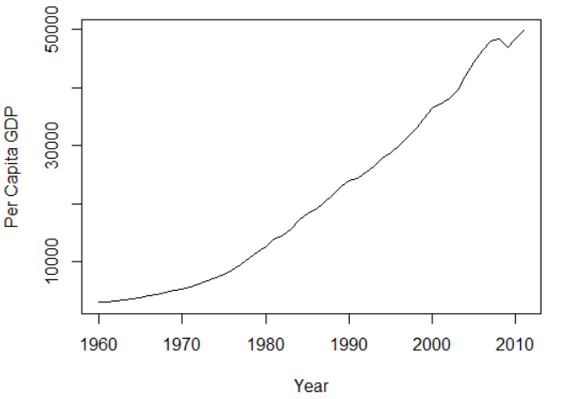
>plot(us,ylab="Per Capita GDP",xlab="Year")
Another way to assess a time series is to view its autocovariance function (ACF) and partial autocovariance function (PACF).
In R this is done with the appropriately named acf and pacf functions.
the ACF shows the correlation of a time series with lags of itself. That is, how much the time series is correlated with itself at one lag, at two lags, at three lags and so on.
The PACF is a little more complicated. The autocorrelation at lag one can have lingering effects on the autocorrelation at lag two and onward.
The partial autocorrelation is the amount of correlation between a time series and lags of itself that is not explained by the previous lag.

Slide 42
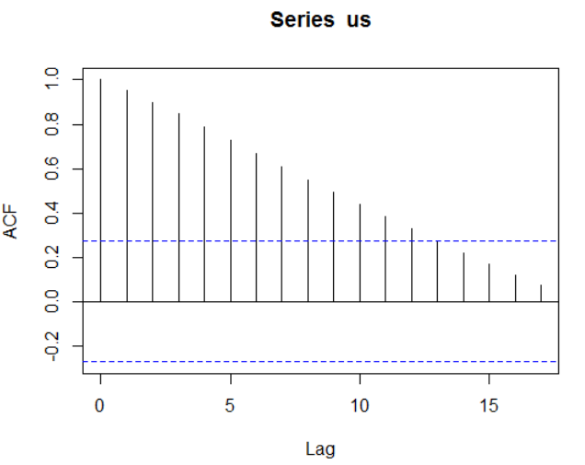
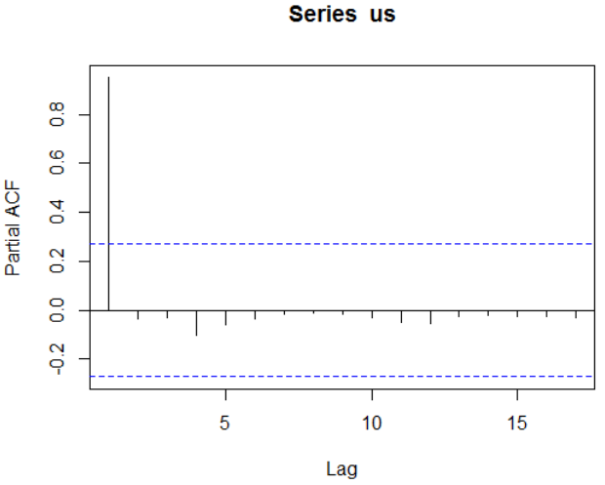
So, the partial autocorrelation at lag two is the correlation between the time series and its second lag that is not explained by the first lag.
The ACF and PACF for the U.S Per Capita GDP data (vertical lines that extend beyond the horizontal line indicates autocorrelations and partial autocorrelations that are significant at those lags.
>acf(us)
>pacf(us)

Slide 43
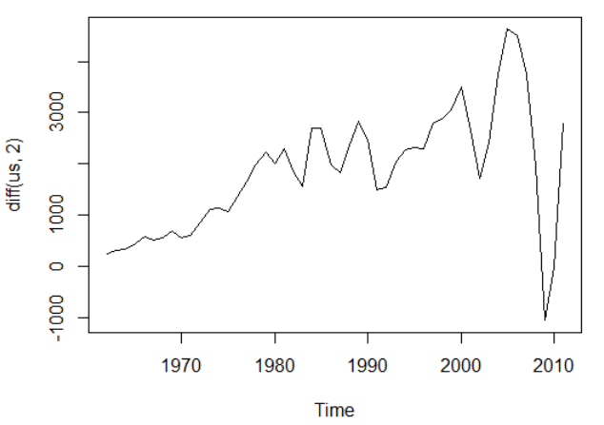
>x<-c(1,4,8,2,6,6,5,3)
>diff(x,difference=1)
[1] 3 4 -6 4 0 -1 -2
>diff(x,difference=2)
[1] 1 -10 10 -4 -1 -1
>diff(x,lag=1)
[1] 3 4 -6 4 0 -1 -2
>diff(x,lag=2)
[1] 7 -2 -2 4 -1 -3
>install.packages("forecast")
>require(forecast)
>ndiffs(x=us)
[1] 2
>plot(diff(us,2))

Slide 44
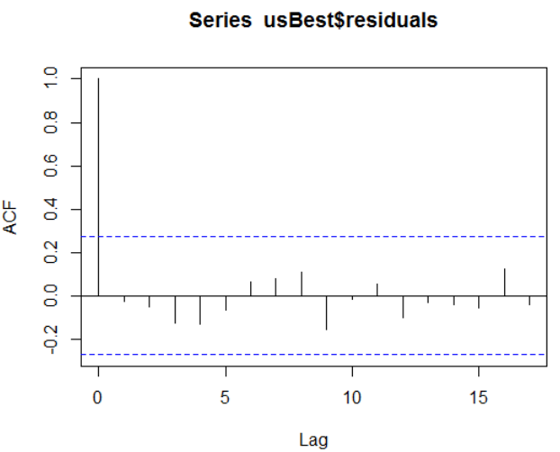
>usBest<-auto.arima(x=us)
>usBest
Series:
ARIMA(0,2,2)
Coefficients:
ma1 ma2
-0.3898 -0.3875
s.e. 0.1339 0.1267
sigma^2 estimated as 296081: log likelihood=-385.31
AIC=776.62 AICc=777.14 BIC=782.35
>acf(usBest$residuals)

Slide 45
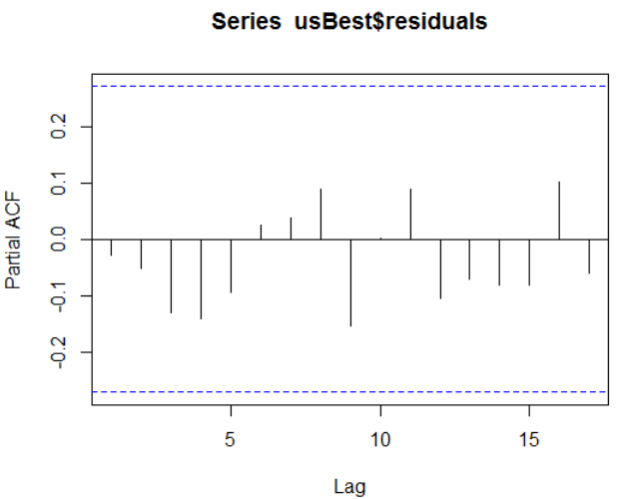
>pacf(usBest$residuals)
>coef(usBest)
ma1 ma2
-0.3898261 -0.3874942
>predict(usBest,n.ahead=5,se.fit=TRUE)
$pred
Time Series:
Start = 2012
End = 2016
Frequency = 1
[1] 50778.46 51875.18 52971.90 54068.62 55165.35
$se
Time Series:
Start = 2012
End = 2016
Frequency = 1
[1] 544.1332 1031.3671 1434.6979 1819.1658 2201.3858

Slide 46
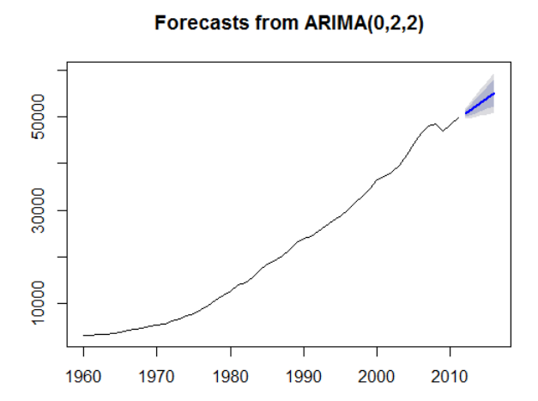
>theForecast<-forecast(object=usBest,h=5)
>plot(theForecast)

Slide 47
2. VAR
When dealing with multiple time series where each depends on its own past, others pasts and other presents, things gets more complicated.
The first thing we will do is convert all of the GDP data into a multivariate time series.
To do this we first cast the data.frame to wide format then call ts to convert it.
>#load reshape2
>require(reshape2)
>#cast the data.frame to wide format
gdpCast<-dcast(Year~Country, data=gdp[,c("Country","Year","PerCapGDP")],value.var = "PerCapGDP")
>head(gdpCast)
>#convert to time series
>gdpTS<-ts(data=gdpCast[,-1],start=min(gdpCast$Year),end=max(gdpCast$Year))
>#build a plot and legend using base graphics
>plot(gdpTS,plot.type = "single",col=1:8)

Slide 48
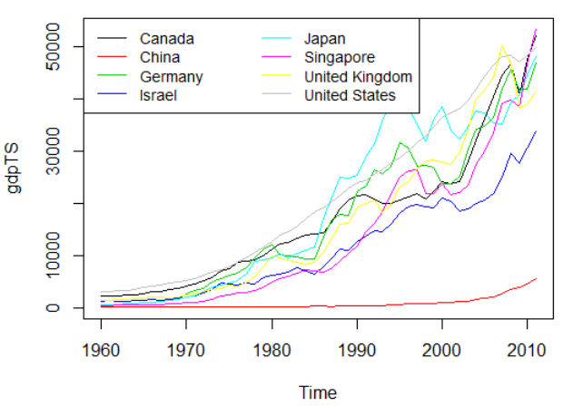
>legend("topleft",legend=colnames(gdpTS),ncol=2,lty=1,col=1:8,cex=.9)
Before proceeding we have to deal with the NA’s for Germany. For some reason the World Bank does not have data on Germany’s GDP before 1970.
There are other resources, such as St.Louis Federal Reserve Economic Data(FRED), but their data do not agree well with the World Bank data, so we remove Germany from our data.
>gdpTS<-gdpTS[,which(colnames(gdpTS)!= "Germany")]

Slide 49
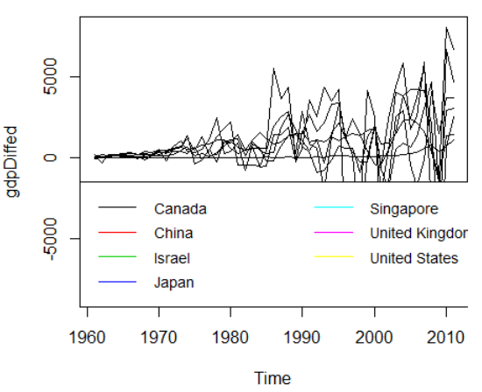
The most common way of fitting a model to multiple time series is to use a vector autoregressive (VAR) model.
While ar can compute a VAR, it often has problems with singular matrices when the AR order is high, so it is better to use VAR from the vars package.
To check whether the data should be diffed, we use the ndiffes function on gdpTS and then apply that number of diffs.
>numDiffs<-ndiffs(gdpTS)
>numDiffs
[1] 1
>gdpDiffed<-diff(gdpTS,differences=numDiffs)
>plot(gdpDiffed,plot.type = "single",cols=1:7)
>legend("bottomleft",legend=colnames(gdpDiffed),ncol=2,lty=1,col=1:7,cex=.9)

Slide 50
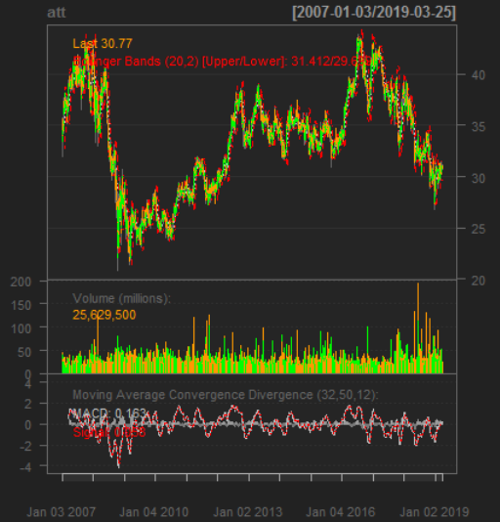
3. GARCH
A problem with ARMA models is that they do not handle extreme events or high volatility well.
To overcome this a good tool to use is generalized autoregressive conditional heteroskedasticity or the GARCH family of models, which in addition to modeling the mean of the process also model the variance.
>require(quantmod)
>att<-getSymbols("T",auto.assign=FALSE)
>att
>require(xts)
>head(att)
>plot(att)
>chartSeries(att)
>addBBands()
>addMACD(32,50,12)
Series chart for AT&T

Slide 51
We are only interested in the closing price, so we create a variable holding just that.
>attClose<-att$T.Close
>class(attClose)
[1] "xts" "zoo“
>head(attClose)
T.Close
2007-01-03 34.95
2007-01-04 34.50
2007-01-05 33.96
2007-01-08 33.81
2007-01-09 33.94
2007-01-10 34.03
The package most widely considered to be the best for fitting GARCH models is rugarch.
There are other packages for fitting GARCH models, such as tseries, fGarch and bayesGARCH, but we will focus on rugarch.
Generally GARCH(1,1) will be sufficient so we will fit that model to the data.

Slide 52
The first step is setting up the model specification using ugarchspec. We specify the volatility to be modeled as a GARCH(1,1) and the mean to be modeled as an ARMA(1,1).
We also specify that the innovation distribution should be the t distribution.
>install.package(“rugarch”)
>require(rugarch)
>attSpec<-ugarchspec(variance.model=list(model="sGARCH“, garchOrder=c(1,1)),mean.model=list(armaOrder=c(1,1)),distribution.model = "std")
The next step is to fit the model using ugarchfit.
>attGarch<-ugarchfit(spec=attSpec,data=attClose)
>attGarch
*---------------------------------*
* GARCH Model Fit *
*---------------------------------*
Conditional Variance Dynamics
-----------------------------------
GARCH Model : sGARCH(1,1)

Slide 53
Mean Model : ARFIMA(1,0,1)
Distribution : std
Optimal Parameters
------------------------------------
Estimate Std. Error t value Pr(>|t|)
mu 35.020833 0.324477 107.93021 0.000000
ar1 0.996755 0.001160 859.33792 0.000000
ma1 -0.003829 0.018109 -0.21143 0.832551
omega 0.001567 0.000550 2.84737 0.004408
alpha1 0.044523 0.008178 5.44435 0.000000
beta1 0.947374 0.009382 100.97567 0.000000
shape 5.317563 0.492993 10.78628 0.000000
Robust Standard Errors:
Estimate Std. Error t value Pr(>|t|)
mu 35.020833 0.093926 372.85481 0.000000
ar1 0.996755 0.001081 922.20587 0.000000
ma1 -0.003829 0.018810 -0.20355 0.838707
omega 0.001567 0.000610 2.56855 0.010213
alpha1 0.044523 0.010298 4.32348 0.000015
beta1 0.947374 0.011461 82.66368 0.000000
shape 5.317563 0.516419 10.29699 0.000000

Slide 54
LogLikelihood : -1385.668
Information Criteria
------------------------------------
Akaike 0.90521
Bayes 0.91893
Shibata 0.90520
Hannan-Quinn 0.91014
Weighted Ljung-Box Test on Standardized Residuals
------------------------------------
statistic p-value
Lag[1] 0.078 0.7800
Lag[2*(p+q)+(p+q)-1][5] 2.594 0.7264
Lag[4*(p+q)+(p+q)-1][9] 4.332 0.6119
d.o.f=2
H0 : No serial correlation
Weighted Ljung-Box Test on Standardized Squared Residuals
------------------------------------
statistic p-value
Lag[1] 0.7637 0.3822
Lag[2*(p+q)+(p+q)-1][5] 1.4044 0.7634
Lag[4*(p+q)+(p+q)-1][9] 3.4425 0.6842
d.o.f=2

Slide 55
Weighted ARCH LM Tests
------------------------------------
Statistic Shape Scale P-Value
ARCH Lag[3] 0.3219 0.500 2.000 0.5705
ARCH Lag[5] 0.4133 1.440 1.667 0.9089
ARCH Lag[7] 2.7459 2.315 1.543 0.5628
Nyblom stability test
------------------------------------
Joint Statistic: 4.6242
Individual Statistics:
mu 0.47721
ar1 0.08977
ma1 0.09391
omega 0.10109
alpha1 1.03553
beta1 0.47932
shape 1.74524
Asymptotic Critical Values (10% 5% 1%)
Joint Statistic: 1.69 1.9 2.35
Individual Statistic: 0.35 0.47 0.75

Slide 56
Sign Bias Test
------------------------------------
t-value prob sig
Sign Bias 0.08041 0.9359
Negative Sign Bias 0.36999 0.7114
Positive Sign Bias 0.62487 0.5321
Joint Effect 0.85683 0.8358
Adjusted Pearson Goodness-of-Fit Test:
------------------------------------
group statistic p-value(g-1)
1 20 26.94 0.10608
2 30 40.12 0.08193
3 40 43.69 0.27898
4 50 62.15 0.09838
Elapsed time : 1.180067

Slide 57
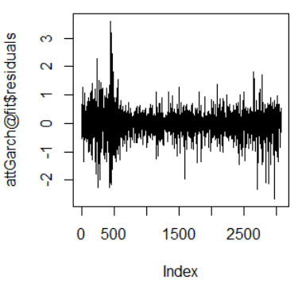
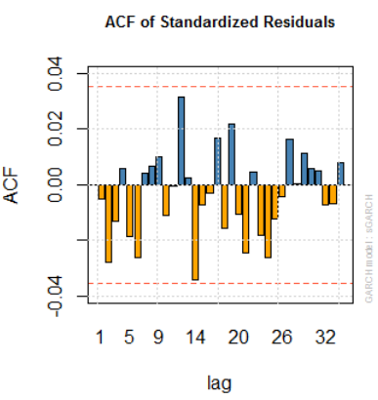
>plot(attGarch@fit$residuals,type="l")
>plot(attGarch, which=10)
Residuals
ACF of residuals

Slide 58
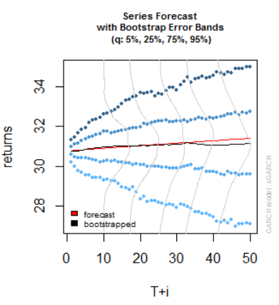
>attPred<-ugarchboot(attGarch,n.ahead = 50,method=c("Partial","Full")[1])
>plot(attPred,which=2)
Predictions for GARCH model on AT&T data

Slide 59
4. Clustering
Play’s a big role in modern machine learning, is the partitioning of data into groups.
This can be done in a number of ways, the two most popular being K-means and hierarchical clustering.
In terms of a data.frame, a clustering algorithm finds out which rows are similar to each other.
Rows that are grouped together are supposed to have high similarity to each other and low similarity with rows outside the grouping.
1. K-means
One of the more popular algorithms for clustering is K-means.
It divides the observations into discrete groups based on some distance metric.
For K-means we need to specify the number of clusters, and then the algorithm assigns observations into that many clusters.
In R, K-means is done with the aptly named K-means function. The first 2 arguments are the data to be clustered, which must be all numeric(K-means does not work with categorical data), and the number of centers(clusters).

Slide 60
Printing the K-means objects displays the size of the clusters, the cluster mean for each column, the cluster membership for each row and similarity measures.
Plotting the results of K-means clustering can be difficult because of high dimensional nature of the data. To overcome this, the plot.kmeans function in useful performs multidimensional scaling to project the data into two dimensions, and then color codes the points according to cluster membership.
Code:
> library(datasets)
>head(iris)
Petal.Width Species
1 0.2 setosa
2 0.2 setosa
3 0.2 setosa
4 0.2 setosa
5 0.2 setosa
6 0.4 setosa

Slide 61
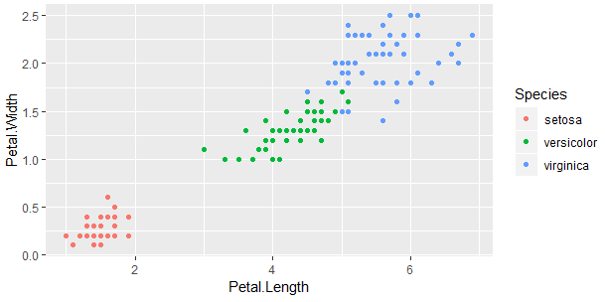
>library(ggplot2)
>ggplot(iris,aes(Petal.Length,Petal.Width,color=Species))+geom_point()

Slide 62
>set.seed(20)
>irisCluster<-kmeans(iris[,3:4],3,nstart=20)
>irisCluster
Clustering vector:
[1] 1 1 1 1 1 1 1 1 1 1 1 1 1 1 1 1 1 1 1 1 1 1 1 1
[25] 1 1 1 1 1 1 1 1 1 1 1 1 1 1 1 1 1 1 1 1 1 1 1 1
[49] 1 1 2 2 2 2 2 2 2 2 2 2 2 2 2 2 2 2 2 2 2 2 2 2
[73] 2 2 2 2 2 3 2 2 2 2 2 3 2 2 2 2 2 2 2 2 2 2 2 2
[97] 2 2 2 2 3 3 3 3 3 3 2 3 3 3 3 3 3 3 3 3 3 3 3 2
[121] 3 3 3 3 3 3 2 3 3 3 3 3 3 3 3 3 3 3 2 3 3 3 3 3
[145] 3 3 3 3 3 3
Within cluster sum of squares by cluster:
[1] 2.02200 13.05769 16.29167
(between_SS / total_SS = 94.3 %)
Available components:
[1] "cluster" "centers" "totss"
[4] "withinss" "tot.withinss" "betweenss"
[7] "size" "iter" "ifault"
>

Slide 63
>table(irisCluster$cluster,iris$Species)
setosa versicolor virginica
1 50 0 0
2 0 48 4
3 0 2 46
> irisCluster$cluster<-as.factor(irisCluster$cluster)
>irisCluster$cluster
[1] 1 1 1 1 1 1 1 1 1 1 1 1 1 1 1 1 1 1 1 1 1 1 1 1
[25] 1 1 1 1 1 1 1 1 1 1 1 1 1 1 1 1 1 1 1 1 1 1 1 1
[49] 1 1 2 2 2 2 2 2 2 2 2 2 2 2 2 2 2 2 2 2 2 2 2 2
[73] 2 2 2 2 2 3 2 2 2 2 2 3 2 2 2 2 2 2 2 2 2 2 2 2
[97] 2 2 2 2 3 3 3 3 3 3 2 3 3 3 3 3 3 3 3 3 3 3 3 2
[121] 3 3 3 3 3 3 2 3 3 3 3 3 3 3 3 3 3 3 2 3 3 3 3 3
[145] 3 3 3 3 3 3
Levels: 1 2 3

Slide 64
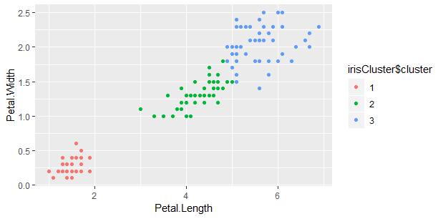
>ggplot(iris,aes(Petal.Length,Petal.Width, color=irisCluster$cluster))+geom_point()

Slide 65
2. PAM
Two problems with K-means clustering are that it does not work with categorical data and it is susceptible to outliers.
An alternative is K-medoids. Instead of the center of a cluster being the mean of the cluster, the center is one of the actual observations in the cluster.
The most common K-mediods algorithm is Partitioning Around Mediods(PAM). The cluster package contains the pam().
If the data has a few missing values, pam handles missing values well. Before we run the clustering algorithm we clean up the data some more.
Now we fit the clustering using pam from the cluster package. Each line represents an observation, and each grouping of lines is a cluster.
Observations that fit the cluster well have large positive lines and observations that do not fit well have small or negative lines.
A bigger average width for a cluster means a better clustering.
Code:
>x<-rbind(cbind(rnorm(10,0,0.5),rnorm(10,0,0.5)),
cbind(rnorm(15,5,0.5),rnorm(15,5,0.5)))

Slide 66
>x
[,1] [,2]
[1,] -0.10815576 -0.409241508
[2,] 0.79507288 -0.771283919
[3,] 0.77807164 0.277941073
[4,] 0.55422545 -0.184514485
[5,] -0.54867092 -0.523669140
[6,] -0.93030286 0.009089958
[7,] -0.45678942 0.440938753
[8,] 0.62278446 0.440930748
[9,] 0.04392736 0.513121593
[10,] 0.21174095 -0.190654590
[11,] 5.54971762 4.169400227
[12,] 4.98454143 5.582606039
[13,] 5.09516971 4.465169011
[14,] 5.66760327 5.454441770
[15,] 5.36527617 4.341246290
[16,] 5.02810095 5.327714978
[17,] 5.66465281 4.669814088
[18,] 4.79594003 5.495790384
[19,] 4.59087145 4.658388232
[20,] 5.17947283 5.560660598
[21,] 5.02935803 5.194275645
[22,] 4.96528171 4.924616605
[23,] 4.80759187 4.767011671
[24,] 4.56283827 4.319742181
[25,] 5.59816533 4.985207120

Slide 67
>library(pamr)
>pamx<-pam(x,2)
>pamx
Medoids:
ID
[1,] 10 0.2117409 -0.1906546
[2,] 22 4.9652817 4.9246166
Clustering vector:
[1] 1 1 1 1 1 1 1 1 1 1 2 2 2 2 2 2 2 2 2 2 2 2 2 2 2
Objective function:
build swap
0.8236515 0.6037261
Available components:
[1] "medoids" "id.med" "clustering" "objective"
[5] "isolation" "clusinfo" "silinfo" "diss"
[9] "call" "data"

Slide 68
>summary(pamx)
Medoids:
ID
[1,] 10 0.2117409 -0.1906546
[2,] 22 4.9652817 4.9246166
Clustering vector:
[1] 1 1 1 1 1 1 1 1 1 1 2 2 2 2 2 2 2 2 2 2 2 2 2 2 2
Objective function:
build swap
0.8236515 0.6037261
Numerical information per cluster:
size max_diss av_diss diameter separation
[1,] 10 1.1593800 0.6674374 1.893649 5.528942
[2,] 15 0.9549435 0.5612518 1.583682 5.528942
Isolated clusters:
L-clusters: character(0)
L*-clusters: [1] 1 2

Slide 69
Silhouette plot information:
cluster neighbor sil_width
10 1 2 0.8956637
1 1 2 0.8881902
4 1 2 0.8783324
9 1 2 0.8655514
5 1 2 0.8633453
7 1 2 0.8573630
8 1 2 0.8474618
3 1 2 0.8442775
6 1 2 0.8406352
2 1 2 0.8265019
21 2 1 0.9142036
22 2 1 0.9137526
16 2 1 0.9092210
23 2 1 0.9010146
25 2 1 0.8990212
20 2 1 0.8938403
13 2 1 0.8921443
12 2 1 0.8898658
17 2 1 0.8866756
18 2 1 0.8865927
14 2 1 0.8801415
15 2 1 0.8787858
19 2 1 0.8751181
11 2 1 0.8520542
24 2 1 0.8412541

Slide 70
Average silhouette width per cluster:
[1] 0.8607322 0.8875790
Average silhouette width of total data set:
[1] 0.8768403
300 dissimilarities, summarized :
Min. 1st Qu. Median Mean 3rd Qu. Max.
0.1335 0.8335 3.7113 3.9761 7.0918 8.6244
Metric : euclidean
Number of objects : 25
Available components:
[1] "medoids" "id.med" "clustering" "objective"
[5] "isolation" "clusinfo" "silinfo" "diss"
[9] "call" "data"

Slide 71
>(p2m<-pam(x,2,medoids=c(1,16)))
Medoids:
ID
[1,] 10 0.2117409 -0.1906546
[2,] 22 4.9652817 4.9246166
Clustering vector:
[1] 1 1 1 1 1 1 1 1 1 1 2 2 2 2 2 2 2 2 2 2 2 2 2 2 2
Objective function:
build swap
0.6728364 0.6037261
Available components:
[1] "medoids" "id.med" "clustering" "objective"
[5] "isolation" "clusinfo" "silinfo" "diss"
[9] "call" "data"

Slide 72
>p2.s<-pam(x,2,medoids=c(1,16),do.swap=FALSE)
>p2.s
Medoids:
ID
[1,] 1 -0.1081558 -0.4092415
[2,] 16 5.0281009 5.3277150
Clustering vector:
[1] 1 1 1 1 1 1 1 1 1 1 2 2 2 2 2 2 2 2 2 2 2 2 2 2 2
Objective function:
build swap
0.6728364 0.6728364
Available components:
[1] "medoids" "id.med" "clustering" "objective"
[5] "isolation" "clusinfo" "silinfo" "diss"
[9] "call" "data"

Slide 73
>p3m<-pam(x,3,trace=2)
C pam(): computing 301 dissimilarities from 25 x 2 matrix: [Ok]
pam()'s bswap(*, s=8.62438, pamonce=0): build 3 medoids:
new repr. 24
new repr. 10
new repr. 16
after build: medoids are 10 16 24
swp new 13 <-> 24 old; decreasing diss. 13.4737 by -1.16452
end{bswap()}, end{cstat()}
>(p3m.<-pam(x,3,medoids = 3:1,trace=1))
C pam(): computing 301 dissimilarities from 25 x 2 matrix: [Ok]
pam()'s bswap(*, s=8.62438, pamonce=0): medoids given
after build: medoids are 1 2 3
end{bswap()}, end{cstat()}

Slide 74
C pam(): computing 301 dissimilarities from 25 x 2 matrix: [Ok]
pam()'s bswap(*, s=8.62438, pamonce=0): medoids given
after build: medoids are 1 2 3
end{bswap()}, end{cstat()}
Medoids:
ID
[1,] 1 -0.1081558 -0.4092415
[2,] 8 0.6227845 0.4409307
[3,] 22 4.9652817 4.9246166
Clustering vector:
[1] 1 1 2 2 1 1 1 2 2 1 3 3 3 3 3 3 3 3 3 3 3 3 3 3 3
Objective function:
build swap
3.9953828 0.5405376
Available components:
[1] "medoids" "id.med" "clustering" "objective"
[5] "isolation" "clusinfo" "silinfo" "diss"
[9] "call" "data"

Slide 75
>pam(daisy(x,metric = "manhattan"),2,diss=TRUE)
Medoids:
ID
[1,] 10 10
[2,] 22 22
Clustering vector:
[1] 1 1 1 1 1 1 1 1 1 1 2 2 2 2 2 2 2 2 2 2 2 2 2 2 2
Objective function:
build swap
1.0639279 0.7823442
Available components:
[1] "medoids" "id.med" "clustering" "objective"
[5] "isolation" "clusinfo" "silinfo" "diss"
[9] "call"

Slide 76
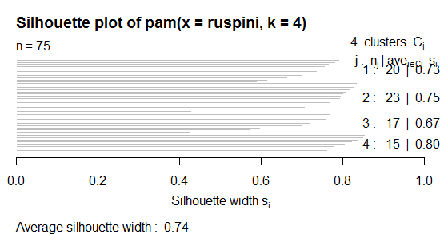
>data("ruspini")
>plot(pam(ruspini,4),ask=TRUE)
Make a plot selection (or 0 to exit):
1: plot All
2: plot Clusplot
3: plot Silhouette Plot
Selection: 1

Slide 77
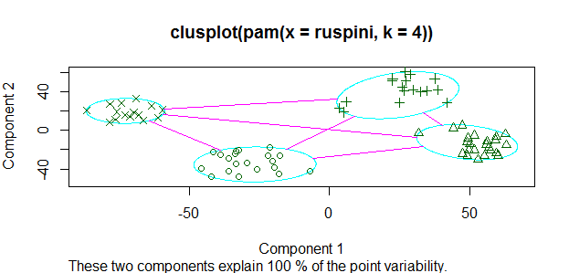
Selection:2

Slide 78
3. Hierarchical Clustering:
Hierarchical Clustering builds clusters within clusters, and does not require a prespecified number of cluster like K-means and K-medoids do.
A Hierarchical Clustering can be thought of as a tree and displayed as a dendogram, at the top there is just one cluster consisting of all the observations, and at the bottom each observation is an entire cluster.
In between are varying levels of clustering.
Hierarchical clustering also works on categorical data like the country information data. However, its dissimilarity matrix must be calculated differently.
There are a number of ways to compute the distance between clusters and they can have a significant impact on the results of a hierarchical clustering.
Code:
>clusters<-hclust(dist(iris[,3:4]))
>clusters
Call:
hclust(d = dist(iris[, 3:4]))

Slide 79
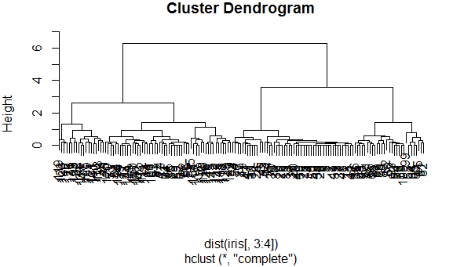
Cluster method : complete
Distance : euclidean
Number of objects: 150
>plot(clusters)

